Slide 1

Bigdeals.com (Advertisement Platform)
Presented by:
Aly Abdelkader Gelany (160040021)
Abdelkarim Mounkambou (160040022)
Supervisor: Faisal Hussain Lecturer, Department Of Computer Science and Engineering(CSE)

Slide 2
Overview
Introduction
Diagrams
Features
Technologies
Conclusion

Slide 3
What is Bigdeals.com
Bigdeals.com is a web application where we can buy and sell almost everything from used items to new items or services.
Users can sign up for free and post advertisement easily or browse through a large categories of items and services Offred in their regions or cities.
Is a digital marketing tool that emphasize on time saving, transparency and consumers satisfaction.

Slide 4
Motivation
provide a cost-effective tool for advertisement as users can post advertisements for free
Develop a platform that bring buyers and sellers closer

Slide 5
Issues
Finding the right advertisement or products is time consuming and a tedious task for customers
The costs in traditional marketing can prove to be a huge investment
The traditional advertisement requires customers to move to the shop before to buy the advertised product or service
With traditional marketing there is no real control over the advertisement.

Slide 6
Objectives
Provide a user-friendly interface for customers to browse through categories and sub-categories according to their regions or cities
Provide an interface for sellers to post and monitors their advertisements for free
Provide purchase facilities to customers through VIP products
Provide an interface for the administrator to monitor and manage the activities of the system

Slide 7
Requirements
The system should be user friendly and intuitive such that it can be understood and use by non-technical persons
Users should have full control on their account and advertisements
The system should be responsive
The system should be secured and protect against attacks such as cross site request forgery and SQL injection

Slide 8
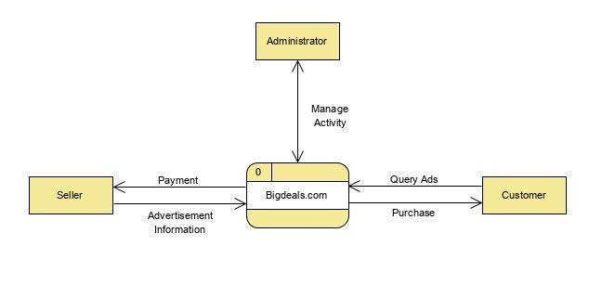
Context Diagram

Slide 9
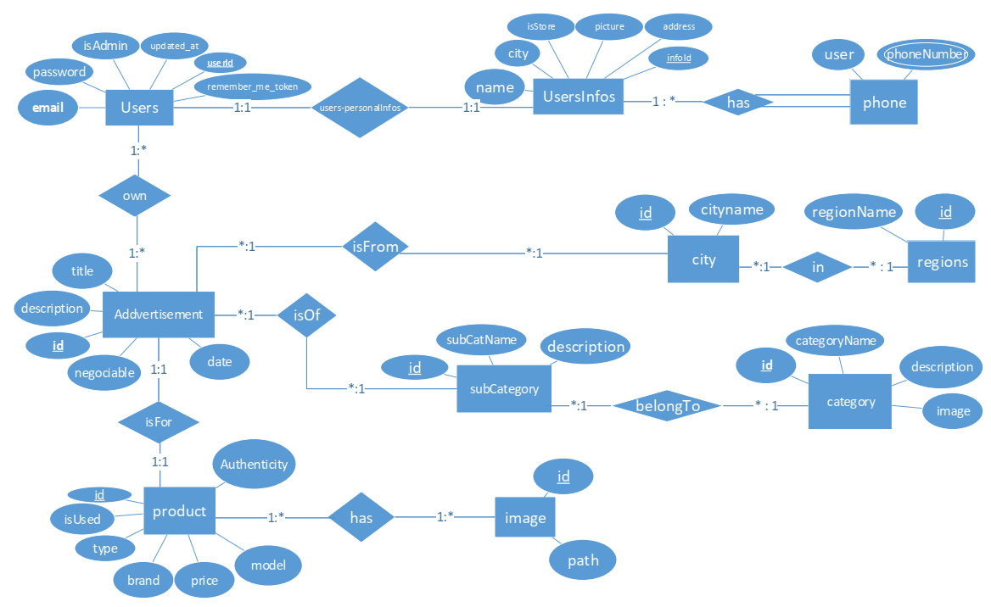
Entity Relationship Diagram (ER)

Slide 10
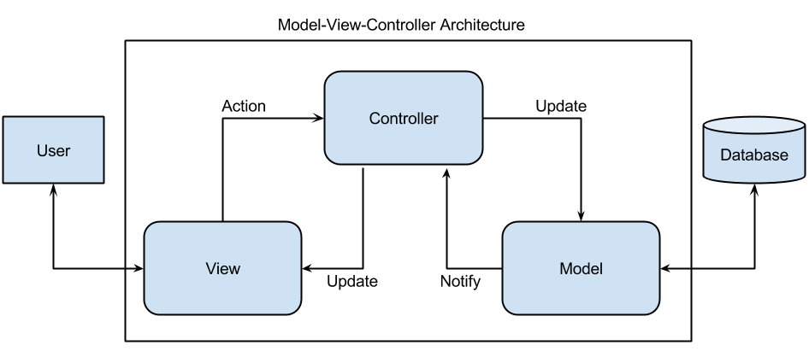
Architectural Diagram

Slide 11
Features
Sellers’ Features:
Login or register
Post unlimited ads for free
Edit his advertisement
Delete his advertisement
Request for VIP badge
Chat with potential buyers

Slide 12
Features
Sellers’ Features:
Login or register
Post unlimited ads for free
Edit his advertisement
Delete his advertisement
Request for VIP badge
Chat with potential buyers
Authenticated Users :
Place an order for VIP products
Cancel his order
Engage in real time communication with sellers
Save advertisement as favorite
Rate sellers

Slide 13
Features
Sellers’ Features:
Login or register
Post unlimited ads for free
Edit his advertisement
Delete his advertisement
Request for VIP badge
Chat with potential buyers
Authenticated Users :
Place an order for VIP products
Cancel his order
Engage in real time communication with sellers
Save advertisement as favorite
Rate sellers
Admin:
Add and manage categories and subcategories
Add and manage regions and cities
Validate and block advertisements
Block and unblock users
Manage orders
Respond to VIP request
Respond to users’ feedback

Slide 14
Technologies(cont…)
Languages
HTML 5
CSS 3
PHP 7.3.2

Slide 15
Technologies
Languages
HTML 5
CSS 3
PHP 7.3.2
Libraries and Frameworks
LARAVEL 5.8
BOOTSTRAP 4.3.1
JQUERY 3.3.1

Slide 16
Technologies
Languages
HTML 5
CSS 3
PHP 7.3.2
Libraries and Frameworks
LARAVEL 5.8
BOOTSTRAP 4.3.1
JQUERY 3.3.1
Web Server
Xampp 7.3.2
www.000webhost.com

Slide 17
Technologies
Languages
HTML 5
CSS 3
PHP 7.3.2
Libraries and Frameworks
LARAVEL 5.8
BOOTSTRAP 4.3.1
JQUERY 3.3.1
Web Server
Xampp 7.3.2
www.000webhost.com
Database Server
MYSQL (10.1.38-MariaDB)

Slide 18
Conclusion
The Internet has become a major resource in modern business, marketing and communication.
using this system can increase business gain and attract more customers and improve the visibility of a business.

Slide 19
Thank you

